Slide 1
Network Security Lecture :
Symmetric Encryption and Message Confidentiality
Assistant professor – Faculty of computers and information – Beni Suef University

Slide 2
Random and pseudorandom Numbers
A number of network security algorithms based on cryptography make use of random numbers
Examples:
Generation of keys for the RSA public-key encryption algorithm and other public-key algorithms
Generation of a symmetric key for use as a temporary session key; used in a number of networking applications such as Transport Layer Security, Wi-Fi, e-mail security, and IP security
In a number of key distribution scenarios, such as Kerberos, random numbers are used for handshaking to prevent replay attacks
Two distinct and not necessarily compatible requirements for a sequence of random numbers are:
Randomness
Unpredictability
Notes:
Random numbers play an important role in the use of encryption for various
network security applications. We provide an overview in this section. The topic is
examined in more detail in Appendix E.
A number of network security algorithms based on cryptography make use of
random numbers. For example,
• Generation of keys for the RSA public-key encryption algorithm (described
in Chapter 3) and other public-key algorithms.
• Generation of a stream key for symmetric stream cipher (discussed in the
following section).
• Generation of a symmetric key for use as a temporary session key. This function
is used in a number of networking applications, such as Transport Layer
Security (Chapter 5), Wi-Fi (Chapter 6), e-mail security (Chapter 7), and IP
security (Chapter 8).
• In a number of key distribution scenarios, such as Kerberos (Chapter 4),
random numbers are used for handshaking to prevent replay attacks.
These applications give rise to two distinct and not necessarily compatible
requirements for a sequence of random numbers: randomness and
unpredictability.

Slide 3
Randomness
The following criteria are used to validate that a sequence of numbers is random:
Uniform distribution
The distribution of bits in the sequence should be uniform
Frequency of occurrence of ones and zeros should be approximately the same
Independence
No one subsequence in the sequence can be inferred from the others
There is no test to “prove” independence
The general strategy is to apply a number of tests until the confidence that independence exists is sufficiently strong
Notes:
Traditionally, the concern in the generation of a sequence of allegedly
random numbers has been that the sequence of numbers be random in some well defined
statistical sense. The following criteria are used to validate that a sequence
of numbers is random.
• Uniform distribution: The distribution of bits in the sequence should be
uniform; that is, the frequency of occurrence of ones and zeros should
be approximately the same.
• Independence: No one subsequence in the sequence can be inferred from the
others.
Although there are well-defined tests for determining that a sequence of numbers
matches a particular distribution, such as the uniform distribution, there is no
such test to “prove” independence. Rather, a number of tests can be applied to
demonstrate if a sequence does not exhibit independence. The general strategy is
to apply a number of such tests until the confidence that independence exists is sufficiently
strong.

Slide 4
Unpredictability
In applications such as reciprocal authentication and session key generation, the requirement is not so much that the sequence of numbers be statistically random but that the successive members of the sequence are unpredictable
With “true” random sequences, each number is statistically independent of other numbers in the sequence and therefore unpredictable
Care must be taken that an opponent not be able to predict future elements of the sequence on the basis of earlier elements
Notes:
In applications such as reciprocal authentication and session key
generation, the requirement is not so much that the sequence of numbers be statistically
random but that the successive members of the sequence are unpredictable.
With “true” random sequences, each number is statistically independent of other
numbers in the sequence and therefore unpredictable. However, as is discussed
shortly, true random numbers are not always used; rather, sequences of numbers
that appear to be random are generated by some algorithm. In this latter case, care
must be taken that an opponent not be able to predict future elements of the sequence
on the basis of earlier elements.

Slide 5
One-Time Pad
Developed by Gilbert Vernam in 1918, another name: Vernam Cipher
The key
a truly random sequence of 0’s and 1’s
the same length as the message
use one time only
The encryption
adding the key to the message modulo 2, bit by bit.
Encryption
Decryption
m_{i} : plain-text bits.
k_{i} : key (key-stream ) bits
c_{i} : cipher-text bits.

Slide 6
Example
Encryption:
1001001 1000110 plaintext
1010110 0110001 key
0011111 1110110 ciphertext
Decryption:
0011111 1110110 ciphertext
1010110 0110001 key
1001001 1000110 plaintext

Slide 7
One-Time pad practical Problem
Key-stream should be as long as plain-text
Difficult in Key distribution & Management
Solution :
Stream Ciphers
Key-stream is generated in pseudo-random fashion form Relatively short secret key

Slide 8
Stream Cipher Model
Output function appears random
S_{i+1}
S_{i}
S_{i} : state of the cipher
at time t = i.
F : state function.
G : output function.
F
G
Initial state, output and state
functions are controlled by the
secret key.
k_{i}
m_{i}
c_{i}

Slide 9
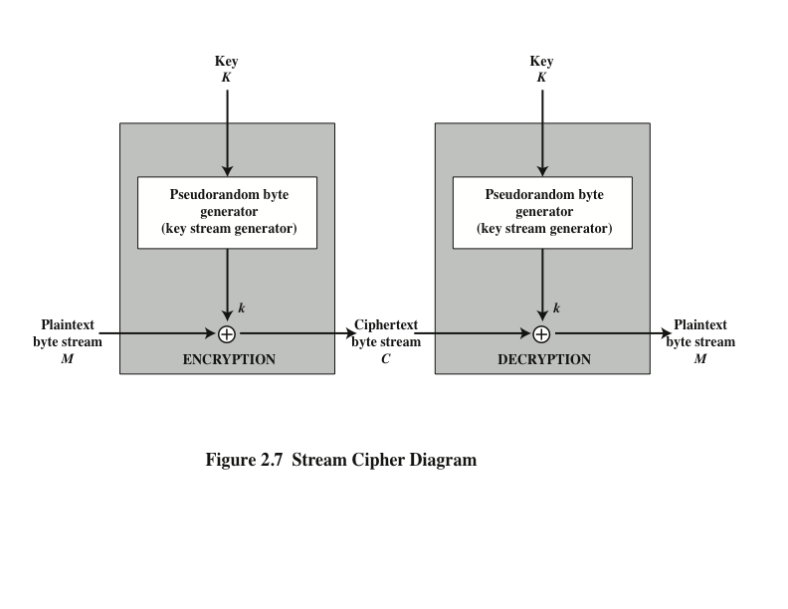
Notes:
A typical stream cipher encrypts plaintext one byte at a time, although a stream
cipher may be designed to operate on one bit at a time or on units larger than a
byte at a time. Figure 2.7 is a representative diagram of stream cipher structure.
In this structure, a key is input to a pseudorandom bit generator that produces a
stream of 8-bit numbers that are apparently random. The pseudorandom stream is
unpredictable without knowledge of the input key and has an apparently random
character. The output of the generator, called a keystream , is combined one byte at
a time with the plaintext stream using the bitwise exclusive-OR (XOR) operation.

Slide 10
RC4 algorithm
A stream cipher designed in 1987 by Ron Rivest for RSA Security
It is a variable key-size stream cipher with byte-oriented operations
The algorithm is based on the use of a random permutation
Is used in the Secure Sockets Layer/Transport Layer Security (SSL/TLS) standards that have been defined for communication between Web browsers and servers
Also used in the Wired Equivalent Privacy (WEP) protocol and the newer WiFi Protected Access (WPA) protocol that are part of the IEEE 802.11 wireless LAN standard
Notes:
RC4 is a stream cipher designed in 1987 by Ron Rivest for RSA Security. It is
a variable key-size stream cipher with byte-oriented operations. The algorithm
is based on the use of a random permutation. Analysis shows that the period of
the cipher is overwhelmingly likely to be greater than 10100 [ROBS95a]. Eight
to sixteen machine operations are required per output byte, and the cipher can
be expected to run very quickly in software. RC4 is used in the Secure Sockets
Layer/Transport Layer Security (SSL/TLS) standards that have been defined
for communication between Web browsers and servers. It is also used in the
Wired Equivalent Privacy (WEP) protocol and the newer WiFi Protected Access
(WPA) protocol that are part of the IEEE 802.11 wireless LAN standard. RC4
was kept as a trade secret by RSA Security. In September 1994, the RC4 algorithm
was anonymously posted on the Internet on the Cypherpunks anonymous
remailers list.
The RC4 algorithm is remarkably simple and quite easy to explain. A
variable-length key of from 1 to 256 bytes (8 to 2048 bits) is used to initialize a
256-byte state vector S, with elements S[0], S[1], . . . , S[255]. At all times, S contains
a permutation of all 8-bit numbers from 0 through 255. For encryption and decryption,
a byte k (see Figure 2.7) is generated from S by selecting one of the 255 entries
in a systematic fashion. As each value of k is generated, the entries in S are once
again permuted.
A number of papers have been published analyzing methods
of attacking RC4 (e.g., [KNUD98], [FLUH00], [MANT01]). None of these
approaches is practical against RC4 with a reasonable key length, such as 128 bits.
A more serious problem is reported in [FLUH01]. The authors demonstrate that
the WEP protocol, intended to provide confidentiality on 802.11 wireless LAN
networks, is vulnerable to a particular attack approach. In essence, the problem is
not with RC4 itself but the way in which keys are generated for use as input to RC4.
This particular problem does not appear to be relevant to other applications using
RC4 and can be remedied in WEP by changing the way in which keys are generated.
This problem points out the difficulty in designing a secure system that involves
both cryptographic functions and protocols that make use of them.

Slide 11
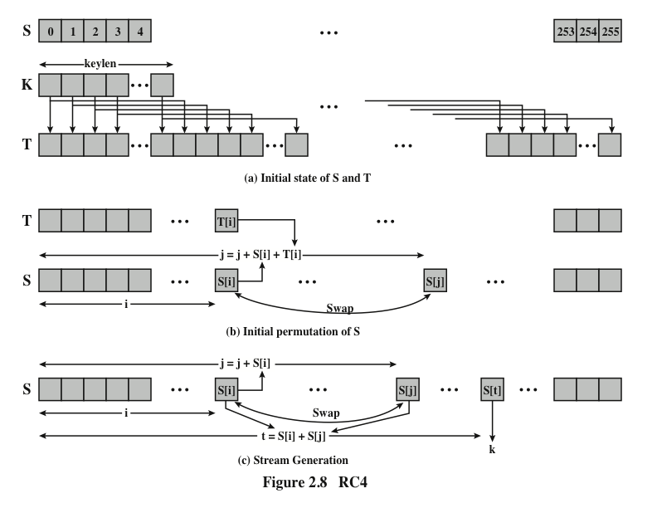
Notes:
Figure 2.8 illustrates the RC4 logic.

Slide 12
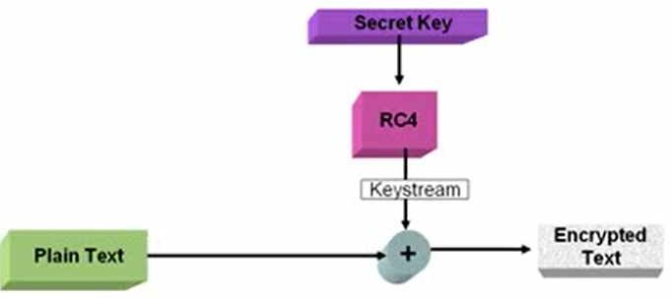
RC4 Block Diagram
Notes:
Figure 2.8 illustrates the RC4 logic.

Slide 13
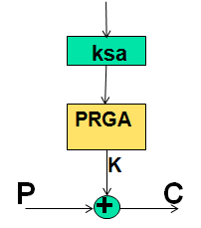
RC4 algorithm
RC4 HAS two main parts:
KSA (Key Scheduling Algorithm)
PRGA (Pseudo Random Generation Algorithm)
Key
State
RC4 is based on the concept of a state.

Slide 14

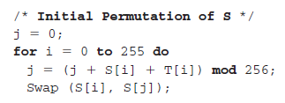
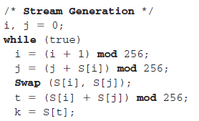
RC4 algorithm
KSA
PRGA
Notes:
Figure 2.8 illustrates the RC4 logic.

Slide 15
RC4 Encryption Example
Lets consider the stream cipher RC4, but instead of the full 256 bytes, we will use 8 x 3-bits.
That is, the state vector S is 8 x 3-bits.
We will operate on 3-bits of plaintext at a time since S can take the values 0 to 7, which can be represented as 3 bits.
Assume we use a 4 x 3-bit key of K = [1 2 3 6]. And a plaintext P = [1 2 2 2]

Slide 16
RC4 Encryption
The first step is to generate the stream.
Initialize the state vector S and temporary vector T. S is initialized so the S[i] = i, and T is initialized so it is the key K (repeated as necessary).
S = [0 1 2 3 4 5 6 7]
T = [1 2 3 6 1 2 3 6]
Now perform the initial permutation on S.
j = 0;
for i = 0 to 7 do
j = (j + S[i] + T[i]) mod 8
Swap(S[i],S[j]);
end
For i = 0:
j = (0 + 0 + 1) mod 8 = 1
Swap(S[0],S[1]);
S = [1 0 2 3 4 5 6 7]

Slide 17
RC4 Encryption
For i = 1:
j = 3
Swap(S[1],S[3])
S = [1 3 2 0 4 5 6 7];
For i = 2:
(3+2+3)mod 8
j = 0
Swap(S[2],S[0]);
S = [2 3 1 0 4 5 6 7];
For i = 3:
(0+0+6)mod 8
j = 6;
Swap(S[3],S[6])
S = [2 3 1 6 4 5 0 7];

Slide 18
RC4 Encryption
For i = 4:
j = 3
Swap(S[4],S[3])
S = [2 3 1 4 6 5 0 7];
For i = 5:
j = 2
Swap(S[5],S[2]);
S = [2 3 5 4 6 1 0 7];
For i = 6:
j = 5;
Swap(S[6],S[5])
S = [2 3 5 4 6 0 1 7];
For i = 7:
j = 2;
Swap(S[7],S[2])
S = [2 3 7 4 6 0 1 5];
Hence, our initial permutation of S= [2 3 7 4 6 0 1 5];

Slide 19
RC4 Encryption
Now we generate 3-bits at a time, k, that we XOR with each 3-bits of plaintext to produce the ciphertext. The 3-bits k is generated by:
i, j = 0;
while (true) {
i = (i + 1) mod 8;
j = (j + S[i]) mod 8;
Swap (S[i], S[j]);
t = (S[i] + S[j]) mod 8;
k = S[t]; }
The first iteration:
S = [2 3 7 4 6 0 1 5]
i = (0 + 1) mod 8 = 1
j = (0 + S[1]) mod 8 = 3
Swap(S[1],S[3])
S = [2 4 7 3 6 0 1 5]
t = (S[1] + S[3]) mod 8 = 7
k = S[7] = 5
Remember, P = [1 2 2 2]

Slide 20
RC4 Encryption
Remember, P = [1 2 2 2]
So our first 3-bits of ciphertext is obtained by: k XOR P
5 XOR 1 = 101 XOR 001 = 100 = 4
The second iteration:
S = [2 4 7 3 6 0 1 5]
i = (1 + 1 ) mod 8 = 2
j = (3 + S[2]) mod 8 = 2
Swap(S[2],S[2])
S = [2 4 7 3 6 0 1 5]
t = (S[2] + S[2]) mod 8 = 6
k = S[6] = 1
Second 3-bits of ciphertext are:
1 XOR 2 = 001 XOR 010 = 011 = 3

Slide 21
RC4 Encryption
The third iteration:
S = [2 4 7 3 6 0 1 5]
i = (2 + 1) mod 8 = 3
j = (2 + S[3]) mod 8 = 5
Swap(S[3],S[5])
S = [2 4 7 0 6 3 1 5]
t = (S[3] + S[5]) mod 8 = 3
k = S[3] = 0
Third 3-bits of ciphertext are:
0 XOR 2 = 000 XOR 010 = 010 = 2

Slide 22
RC4 Encryption
The final iteration:
S = [2 4 7 0 6 3 1 5]
i = (1 + 3 ) mod 8 = 4
j = (5 + S[4]) mod 8 = 3
Swap(S[4],S[3])
S = [2 4 7 6 0 3 1 5]
t = (S[4] + S[3]) mod 8 = 6
k = S[6] = 1
Last 3-bits of ciphertext are:
1 XOR 2 = 001 XOR 010 = 011 = 3

Slide 23
RC4 Encryption
So to encrypt the plaintext stream P with key K with our simplified RC4 stream we get C:
P = [1 2 2 2]
K = [5 1 0 1]
C = [4 3 2 3]
Or in binary:
P = 001010010010
K = 101001000001
C = 100011010011

Slide 24
The End

